Slide 1

Artificial Intelligence & Human Society Pierre-Alexandre Balland
Utrecht University
AI Toulouse Institute
Notes:
What do you remember from last week? What amazed/surprised you the most?

Slide 2
My mission for this class is to help you navigate our complex AI world
Notes:
Organize private trainsings, products, inve strat

Slide 3
Navigating a complex AI world
Gap between the impact AI has on your lives & your understanding of AI
Notes:
AI i

Slide 4
Navigating a complex AI world
Gap between the impact AI has on your lives & your understanding of AI
Overwhelming information (and disinformation): reality ≠ from imagination, hype & anthropomorphism bias
Notes:
AI i

Slide 5
Navigating a complex AI world
Gap between the impact AI has on your lives & your understanding of AI
Overwhelming information (and disinformation): reality ≠ from imagination, hype & anthropomorphism bias
The AI in books & movies is not the AI to worship or worry about
Notes:
AI i

Slide 6
Navigating a complex AI world
Gap between the impact AI has on your lives & your understanding of AI
Overwhelming information (and disinformation): reality ≠ from imagination, hype & anthropomorphism bias
The AI in books & movies is not the AI to worship or worry about
How to benefit from AI: solve real-world problems
Notes:
AI i

Slide 7
Navigating a complex AI world
Gap between the impact AI has on your lives & your understanding of AI
Overwhelming information (and disinformation): reality ≠ from imagination, hype & anthropomorphism bias
The AI in books & movies is not the AI to worship or worry about
How to benefit from AI: solve real-world problems
How to protect yourself from AI: pick the skills of the future
Notes:
AI i

Slide 8
AI is taking the world by storm
Notes:
Organize private trainsings, products, inve strat

Slide 9
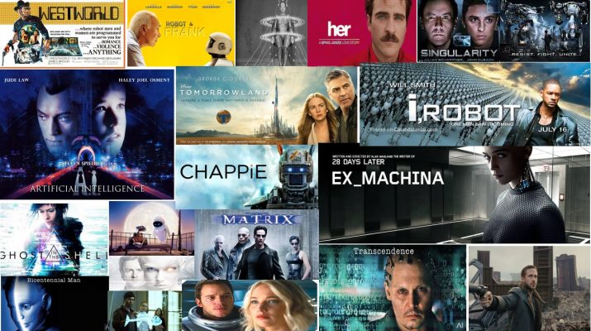
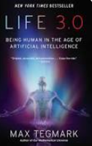
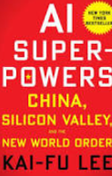
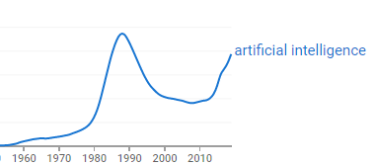
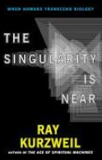

AI is everywhere – cultural products

Slide 10

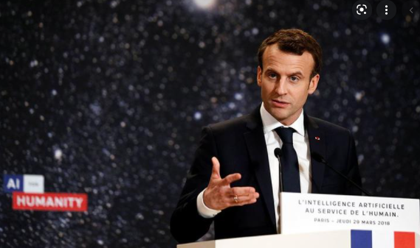
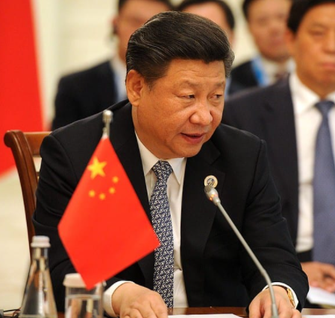
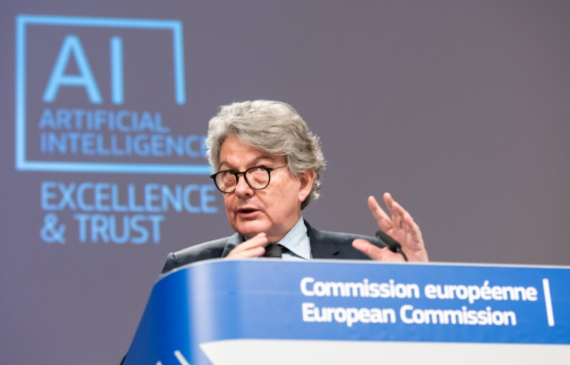
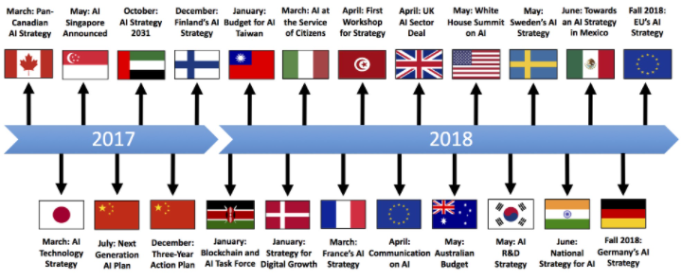
AI is everywhere – national policy
New Generation Artificial Intelligence Development Plan
(新一代人工智能发展规划)
Notes:
July 2017, China’s State Council issued the New Generation Artificial Intelligence Development Plan (AIDP)
China is pursuing a three-step plan to turn AI into a core industry for the country, one that will be worth 150 billion yuan ($22bn) by the end of 2020 to become the world's leading AI power by 2030.

Slide 11

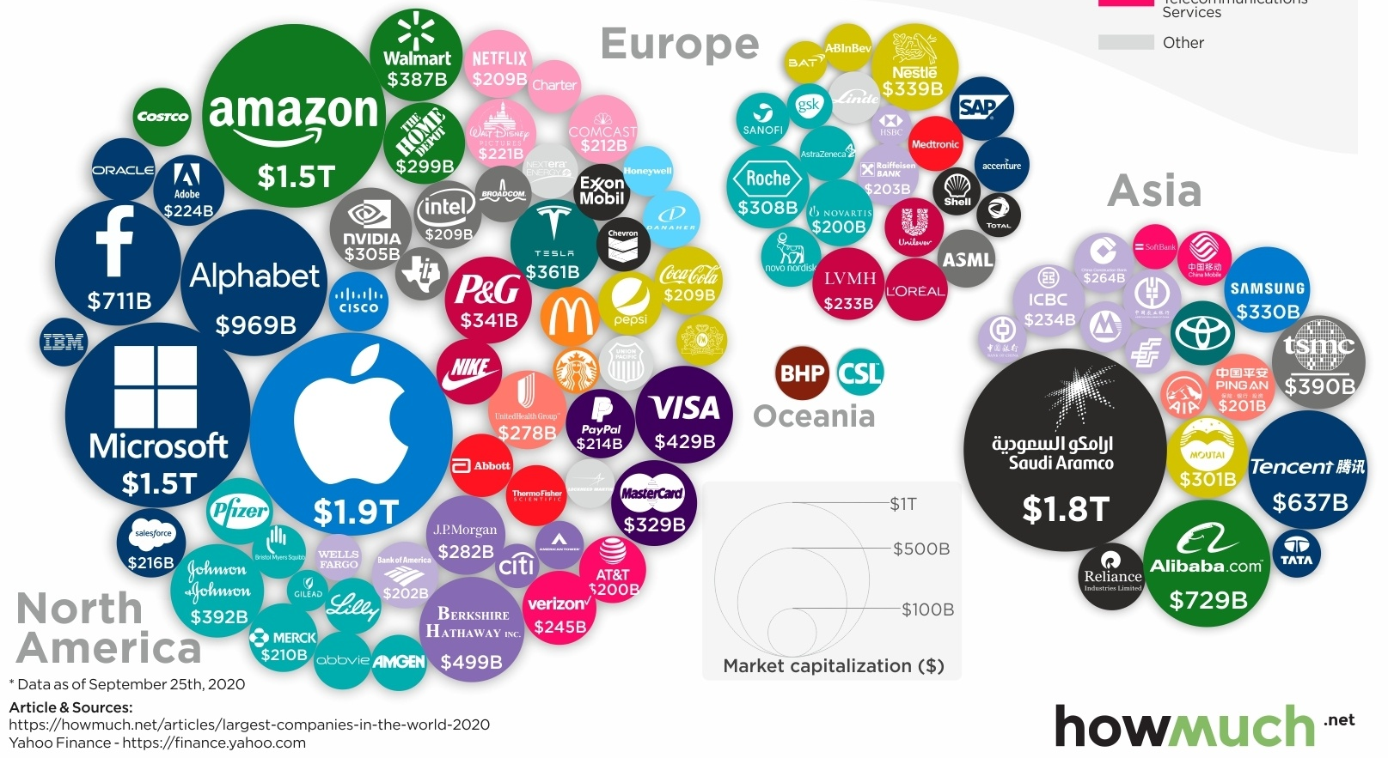
AI is disrupting the global economy
Top 100 companies by market cap
Notes:
July 2017, China’s State Council issued the New Generation Artificial Intelligence Development Plan (AIDP)

Slide 12
How intelligent did machines really become?
Notes:
Organize private trainsings, products, inve strat

Slide 13
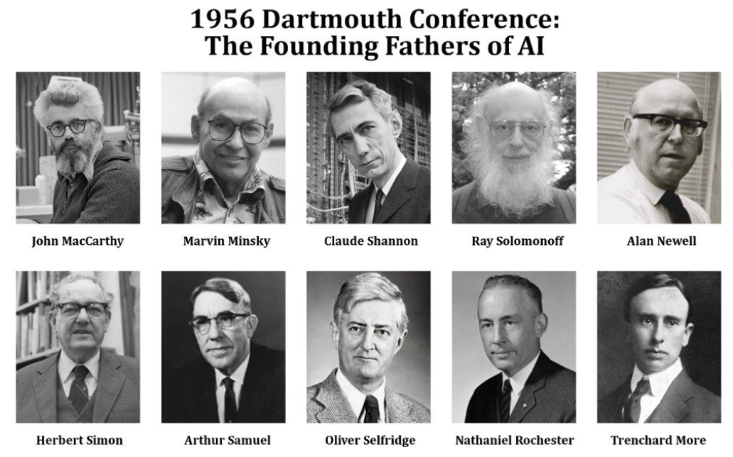
Defining AI
The ability for a machine to perform a specific task that requires human intelligence (narrow AI)

Slide 14
Defining AI
The ability for a machine to perform a specific task that requires human intelligence (narrow AI)
The ability for a machine to learn to perform any task that requires human intelligence (general AI)

Slide 15
Defining AI
The ability for a machine to perform a specific task that requires human intelligence (narrow AI)
The ability for a machine to learn to perform any task that requires human intelligence (general AI)
Above this stage is superintelligence & singularity

Slide 16
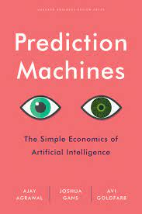
The state-of-the-art
Artificial Intelligence is all about specific AI
Notes:
Data
Computer power (GPUs) & cloud computing services

Slide 17
The state-of-the-art
Artificial Intelligence is all about specific AI
Huge transformative advances have been made in specific/narrow AI (thanks to more data, computer power & better ML/DL algorithms)
Notes:
Data
Computer power (GPUs) & cloud computing services

Slide 18
The state-of-the-art
Artificial Intelligence is all about specific AI
Huge transformative advances have been made in specific/narrow AI (thanks to more data, computer power & better ML/DL algorithms)
Advances are mainly about (internet) data-driven solutions to real-world problems
Notes:
Data
Computer power (GPUs) & cloud computing services

Slide 19
The state-of-the-art
Artificial Intelligence is all about specific AI
Huge transformative advances have been made in specific/narrow AI (thanks to more data, computer power & better ML/DL algorithms)
Advances are mainly about (internet) data-driven solutions to real-world problems
We don’t have intelligent machines - we have fast and accurate prediction machines
Notes:
Data
Computer power (GPUs) & cloud computing services

Slide 20
The state-of-the-art
Artificial Intelligence is all about specific AI
Huge transformative advances have been made in specific/narrow AI (thanks to more data, computer power & better ML/DL algorithms)
Advances are mainly about (internet) data-driven solutions to real-world problems
We don’t have intelligent machines - we have fast and accurate prediction machines
We haven’t made any significant progress in creating AGI
Notes:
Data
Computer power (GPUs) & cloud computing services

Slide 21
The state-of-the-art
Artificial Intelligence is all about specific AI
Huge transformative advances have been made in specific/narrow AI (thanks to more data, computer power & better ML/DL algorithms)
Advances are mainly about (internet) data-driven solutions to real-world problems
We don’t have intelligent machines - we have fast and accurate prediction machines
We haven’t made any significant progress in creating AGI
Singularity is likely to happen but far, far away
Notes:
Data
Computer power (GPUs) & cloud computing services

Slide 22
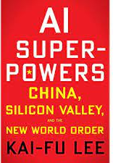
The 4 waves of AI
1: Building recommendation systems with internet data
2: Using private data for decision-making
3: Integrating prediction machines with sensors = perception AI
4: Fully-autonomous AI

Slide 23
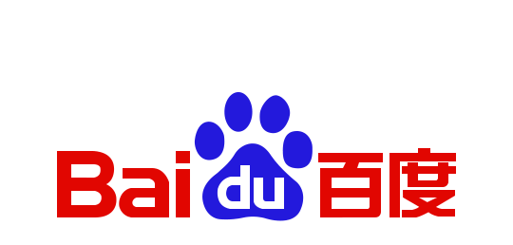





Champions of the first AI wave

Slide 24

Reinforcing Feedback Loops in AI
Google gets
more data
More customers
use Google
Google’s algorithm
gets better
Google’s offers a
better product

Slide 25
Exploiting the network structures (matrices) to make predictions

Slide 26
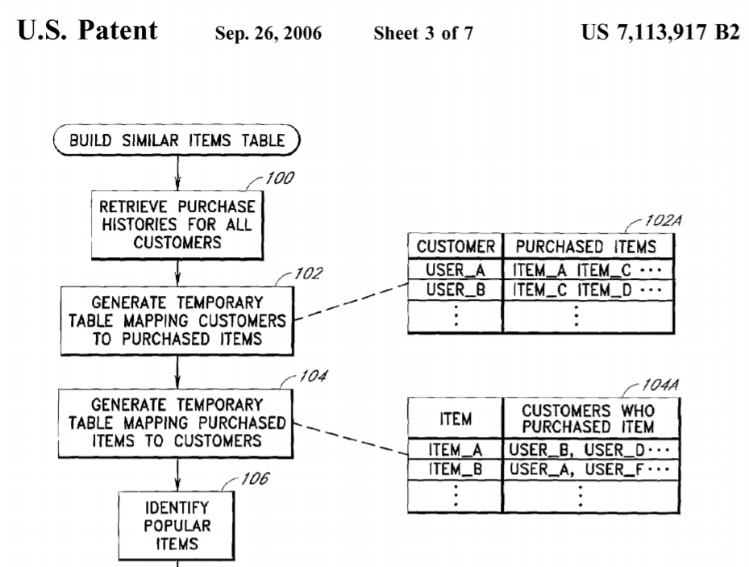
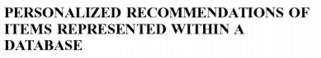
What AI can predict
Modern AI techniques are good at predicting the evolution of simple network structures
Notes:
That you can predict because you see the connections – if you don’t see them forget about it

Slide 27

EU smart specialization ($120 billion )
Complexity
High Risks
High Benefits
Low Risks
High Benefits
High Risks
Low Benefits
Low Risks
Low Benefits
Relatedness
Balland, P.A., Boschma, R., Crespo, J. and Rigby, D. (2019) Smart Specialization policy in the EU: Relatedness, Knowledge Complexity and Regional Diversification, Regional Studies

Slide 28




Private data for decision-making

Slide 29
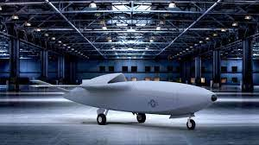
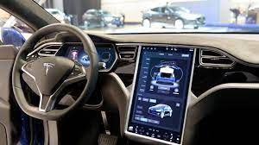
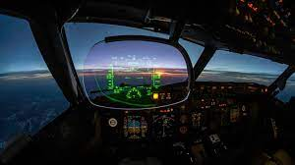

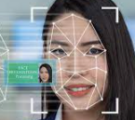
Integrating digital & physical

Slide 30
AI in healthcare
X-ray analysis, tumor detection
Fully automated clinical diagnosis
Predicting future health based on medical records & genetics
Personalized medication
Automated surgical robots (Smart Tissue Autonomous Robot)
AI-enabled dynamic prosthetics (Hugh Herr, Media Lab)

Slide 31

Leveraging complex networks
CODE
Returns are increasingly decoupled from individual efforts
MEDIA
Returns
CAPITAL
LABOR
Leverage
Notes:
Wealth comes from a position of leverage

Slide 32
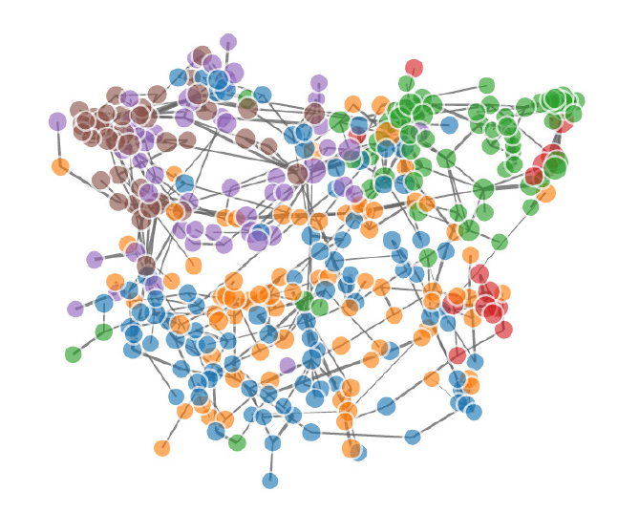
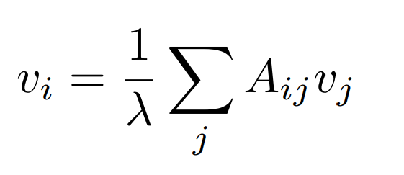
Beyond CS skills
The ability to identify business problems and re-frame them as a data science solution is as important as the programming skills needed to develop AI tools

Slide 33
The future of work
These skills are the foundation of an AI world:
- complex decision-making
- creative content
- business-technology interface
- inter-human relationships
- programming language
They are:
- hard to automate
- requires new modes of education (hard to train at scale)
- requires the re-invention of corporate culture, work ethics and lifestyle
Notes:
Understanding leveraging gives u an indication of the future of work
They require a new education system and professional habits
You might think that these skills are everywhere but they are very concentrated
AI really bad at putting together different domains

Slide 34
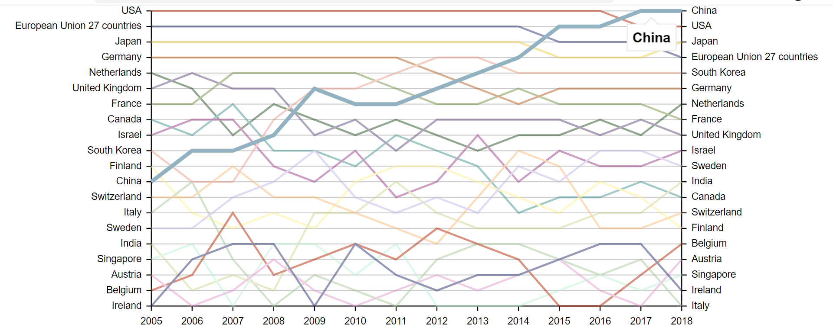
The geography of AI patents
Source: Balland (2021) – Report for DG Grow

Slide 35
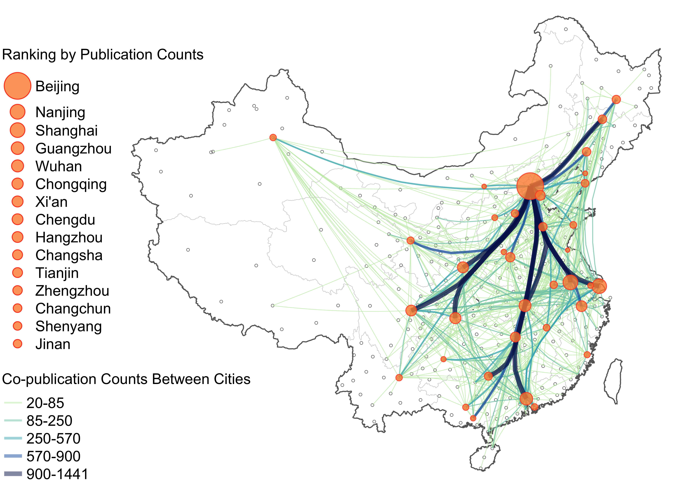
Being in the right place matters (more)
Balland et al. (2020): nature.com/articles/s41562-019-0803-3
Notes:
Complex knowledge does not travel
Individual and corporate needs this choice

Slide 36
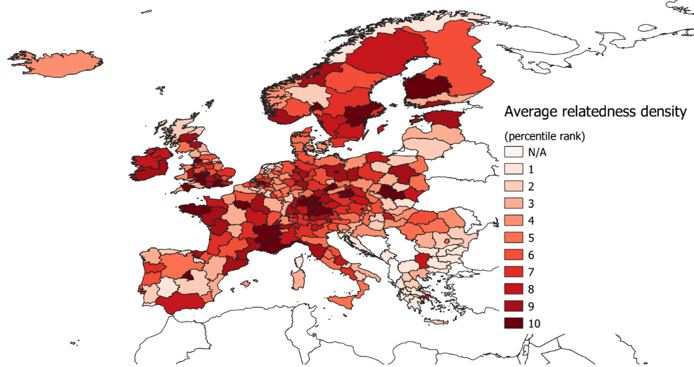
European Hubs of the industries of the future
Balland and Boschma, 2019, World Bank Report on I4.0

Slide 37




Blockchain is the other automation revolution
Crypto will:
disrupt every industry by automating transactions
enable the scaling of AI solutions (structured + interoperable data)
increase hyperconnectivity by providing trust at scale

Slide 38
When the structure of our world is too complex:
what machines can’t predict and
the strength of human wisdom

Slide 39
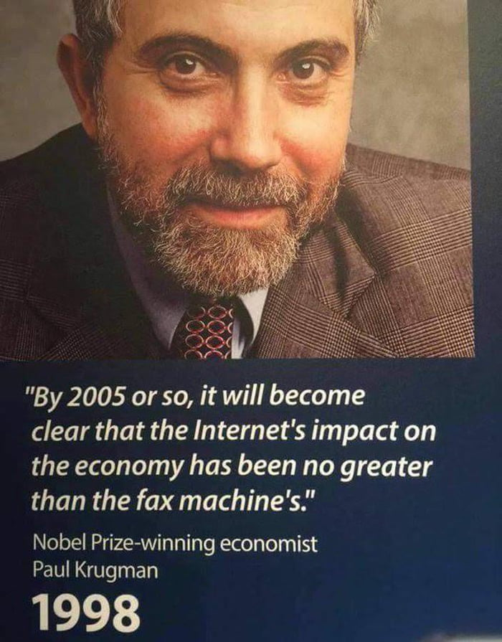

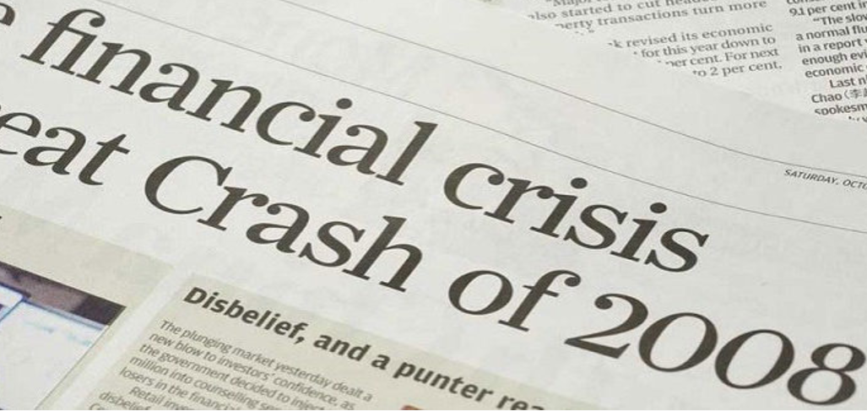
What you can not predict in a complex world
Notes:
Because of complex interactions – super hard to predict
One lesson of complexity theory: hard to predict

Slide 40
Complex systems are governed by fat tails
Most of the world
is very poor
Most humans are
similarly wealthy
Gaussian
(normal)
distribution
% of population
Very few take it all
The ultra-riches do not exist
Fat tails
Wealth
Wealth
Systemic complexity generates probability distributions with relatively high probability of extreme (positive or negative) outcomes that even the best AI can not predict
Notes:
Show the math reflection that the more we move to a complex world, the more unequal
We have been trained to think that the world works this way, changes everything

Slide 41
Complex systems & human wisdom
Complex systems heuristics
→ Leverage, optionality & redundancy
→ Exposed to upside and protect from downside
→ Risks/rewards come from multiplicative systemic effects
Evolutionary collective wisdom
→ Those who used it survived
→ No science – error and feedback evolutionary loops
→ You don’t know you are using it
Notes:
Understanding leveraging gives u an indication of the future of work
They require a new education system and professional habits
You might think that these skills are everywhere but they are very concentrated
AI really bad at putting together different domains

